Slide 1
The Greedy Thick Thinning algorithm
Aims to create the structure of the Bayesian network based on Data.
Computationally Efficient as iteratively adds and removes edges, focusing on improving the network incrementally rather than exploring all possible structures.
Suitable for Large-Scale Problems as it choses the minimum block set to conduct its independence tests.
Performs well even when the data is sparce.

Slide 2
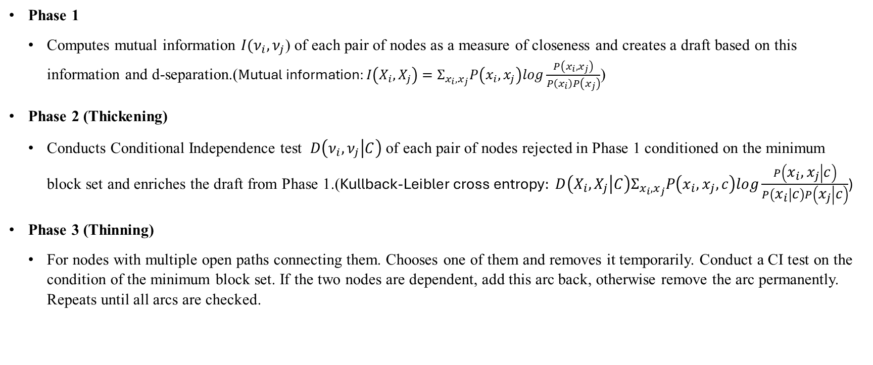
The Greedy Thick Thinning algorithm
Phase 1
Computes mutual information $I(ν_{i},ν_{j}$) of each pair of nodes as a measure of closeness and creates a draft based on this information and d-separation.($\text{M}\text{utual} \text{information}:I\left(X_{i},X_{j}\right)=Σ_{x_{i},x_{j}}P\left(x_{i},x_{j}\right)log\frac{P\left(x_{i},x_{j}\right)}{P\left(x_{i}\right)P\left(x_{j}\right)}$)
Phase 2 (Thickening)
Conducts Conditional Independence test $D\left(ν_{i},ν_{j} | C\right)$ of each pair of nodes rejected in Phase 1 conditioned on the minimum block set and enriches the draft from Phase 1.($\text{Kullback}\text{-}\text{Leibler} \text{cross} \text{entropy}: D\left(X_{i},X_{j} | C\right)Σ_{x_{i},x_{j}}P\left(x_{i},x_{j},c\right)log\frac{P\left(x_{i},x_{j} | c\right)}{P\left(x_{i} | c\right)P\left(x_{j} | c\right)}$)
Phase 3 (Thinning)
For nodes with multiple open paths connecting them. Chooses one of them and removes it temporarily. Conduct a CI test on the condition of the minimum block set. If the two nodes are dependent, add this arc back, otherwise remove the arc permanently. Repeats until all arcs are checked.

Slide 3

The Dirichlet Multinomial Bayesian Model
The Multinomial Distribution
The Multinomial Distribution is a Generalization of the Binomial Distribution.
$$P\left(x_{1},…x_{n};n,p_{1},…,p_{n}\right)=\frac{n!}{x_{1}! … x_{n}!}p_{1}^{x_{1}}…p_{n}^{x_{n}}$$
N = total count of observations.
$x_{1}…x_{n}$ = counts for category $i$.
$p_{1}…p_{n}$ = probability for category $i$.
The Dirichlet Distribution
It is a multivariate generalization of the beta distribution.
$P\left(x_{1},…,x_{n};a_{1},…,a_{n}\right)=\frac{Γ\left(Σ_{i}α_{i}\right)}{Π_{i}Γ\left(α_{i}\right)}Π_{i}x_{i}^{a_{i}−1}$
Where
$Σ_{i}x_{i}=1$ and $0≤x_{i}^{ }≤1 ∀i$. $B\left(a\right)=\frac{Π_{i}Γ\left(α_{i}\right)}{Γ\left(Σ_{i}α_{i}\right)}$.

Slide 4

The Dirichlet Multinomial Bayesian Model
The Posterior
Suppose that
$θ_{1},…,θ_{k}\sim Dir(a_{1},…,a_{k})$ (prior)
$y_{1},…,y_{k}\sim Mult(θ_{1},…,θ_{k})$(likelihood)
$P\left(θ | n\right)=\frac{P\left(n | θ\right)P(θ)}{P(n)}$ ∝ $\frac{N!}{\prod_{i}{n_{i}!}}\prod_{i}{θ_{i}^{n_{i}}}∗\frac{1}{B\left(α\right)}∗\prod_{i}{θ_{i}^{a_{i}−1}}$ ∝ $\prod_{i}{θ_{i}^{n_{i}}}∗\prod_{i}{θ_{i}^{a_{i}−1}}$=
= $\prod_{i}{θ_{i}^{{n_{i}+a}_{i}−1}}$ $\sim Dir(a+n)$.

